Slide 1
Try With Resources
momedaram

Slide 2
Resources ?
File or database connection or network connection etc…
Any resource needs to be released after they are used.
To avoid resource leaks and also make them available for others to use.
Before Java 7, finally blocks are used to close the resources. As we know, finally blocks are executed always.
This makes sure that resources are released after their usage in try block if you keep resources closing statements in finally block.

Slide 3
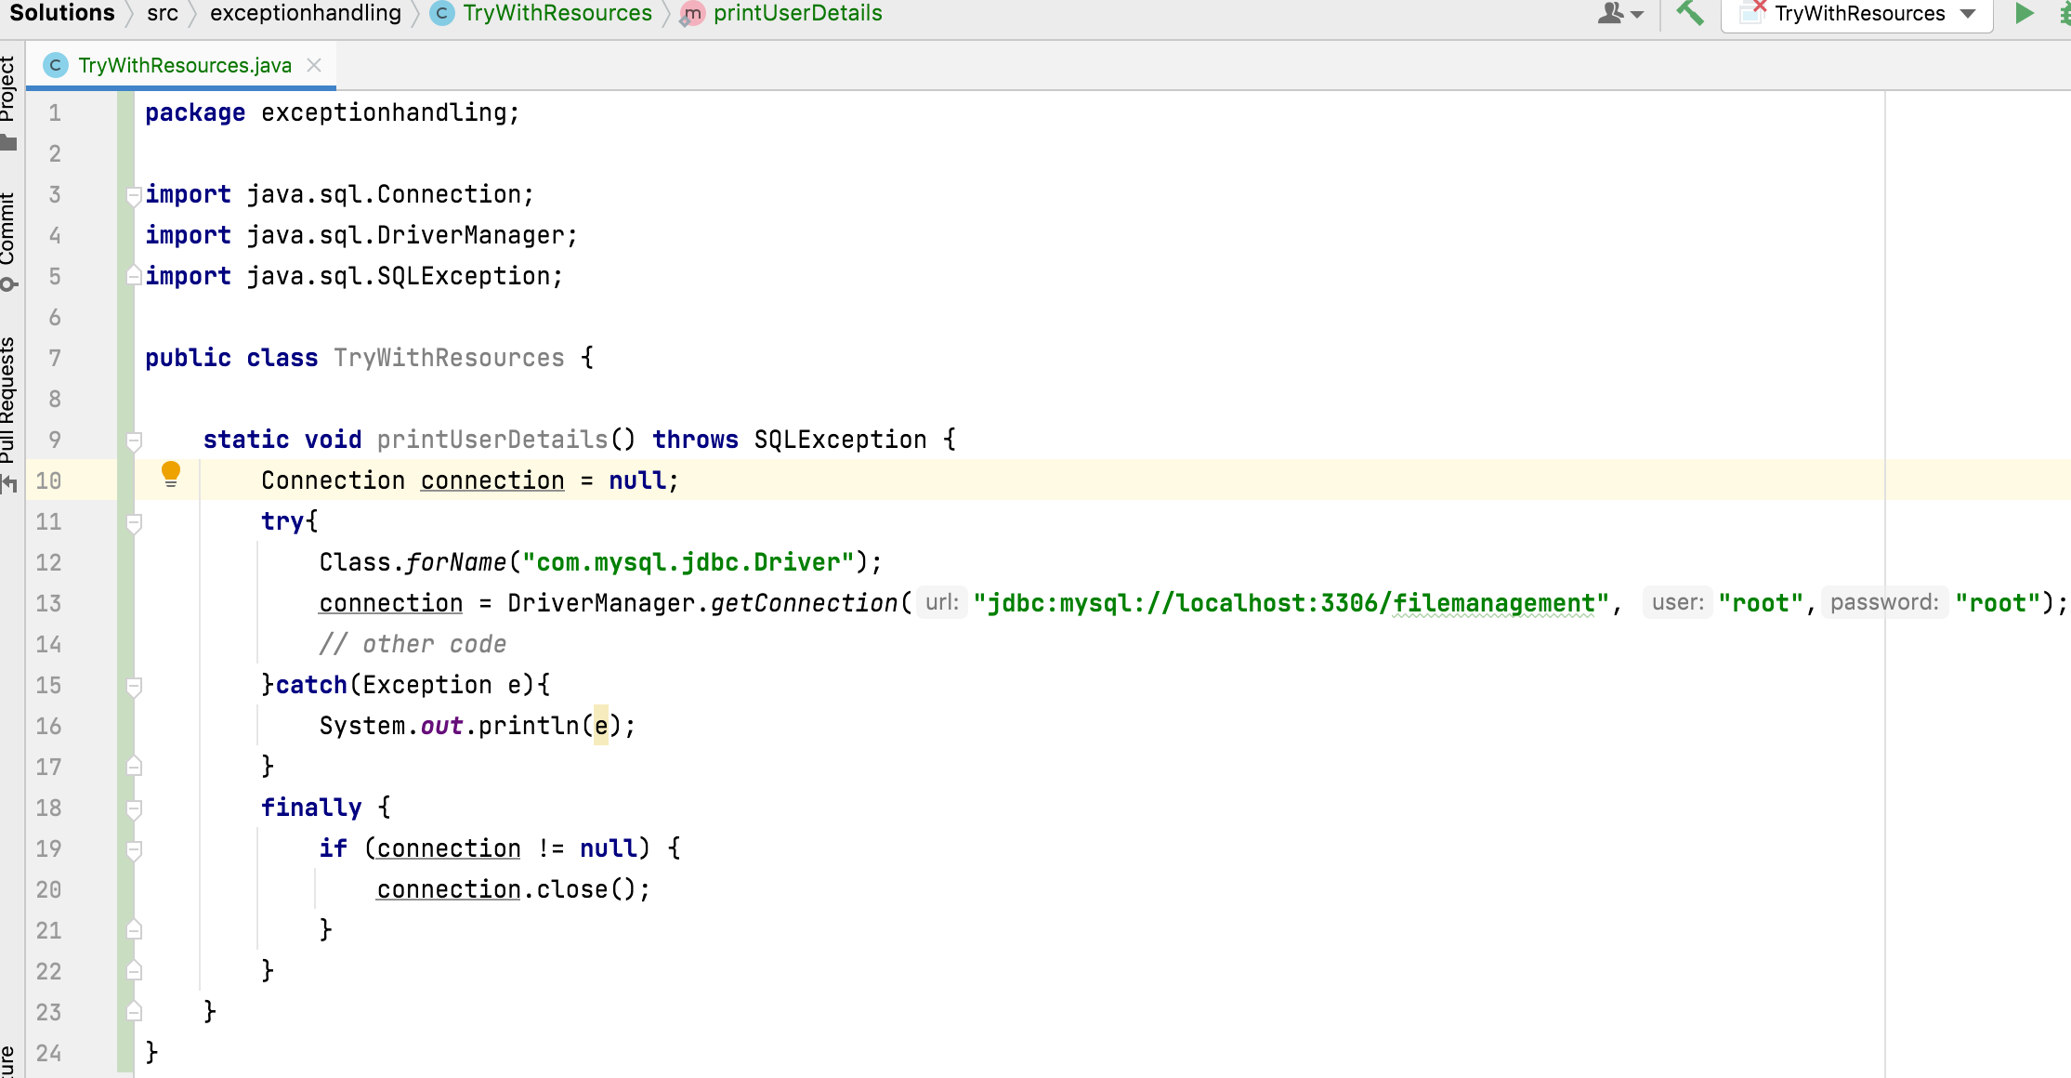
Programmer needs to close the resources compulsory….

Slide 4
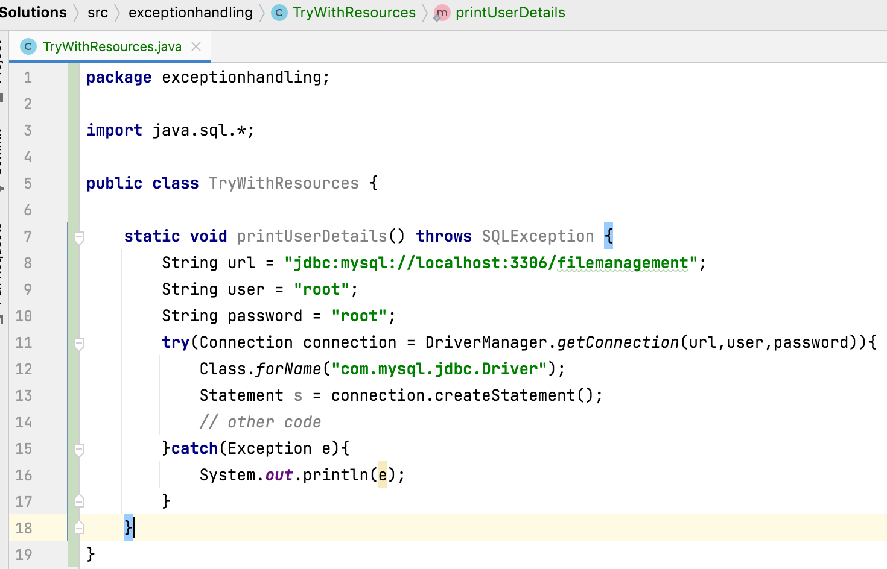
try with resources:
With the introduction of try with resources in Java 7, There is no need to explicitly close the resources as in the above example.
Try with resources auto closes the resources used in try block.

Slide 5
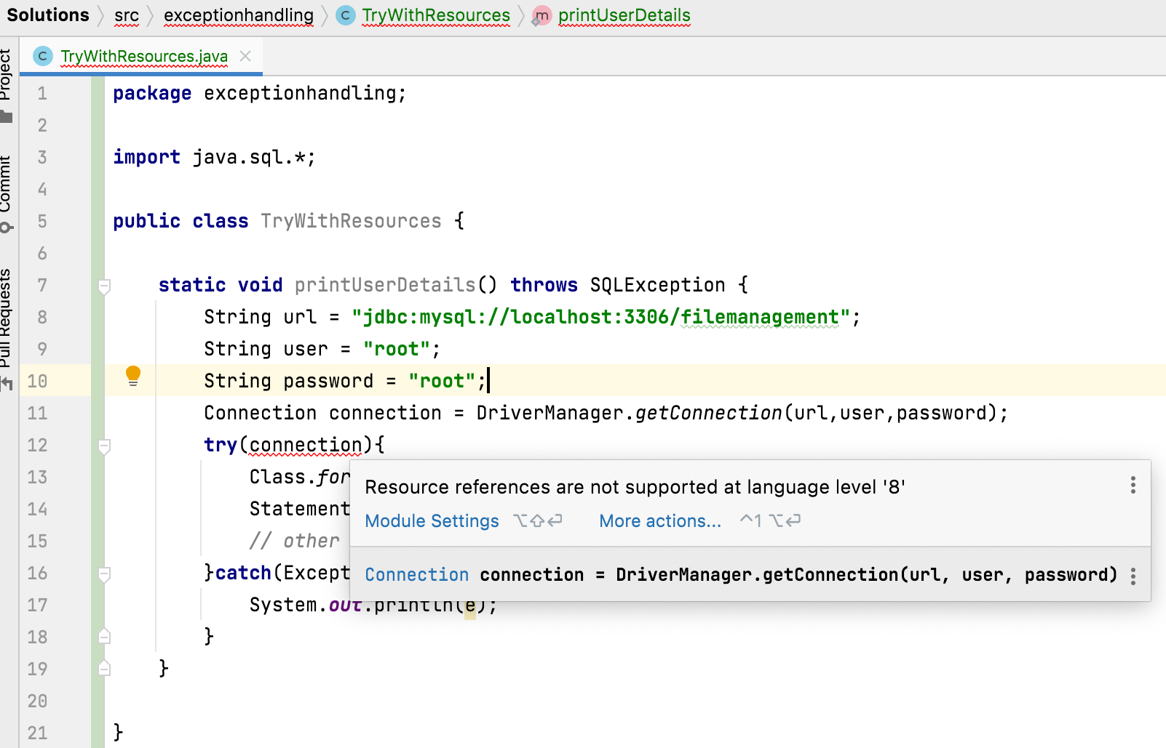
JDK7

Slide 6
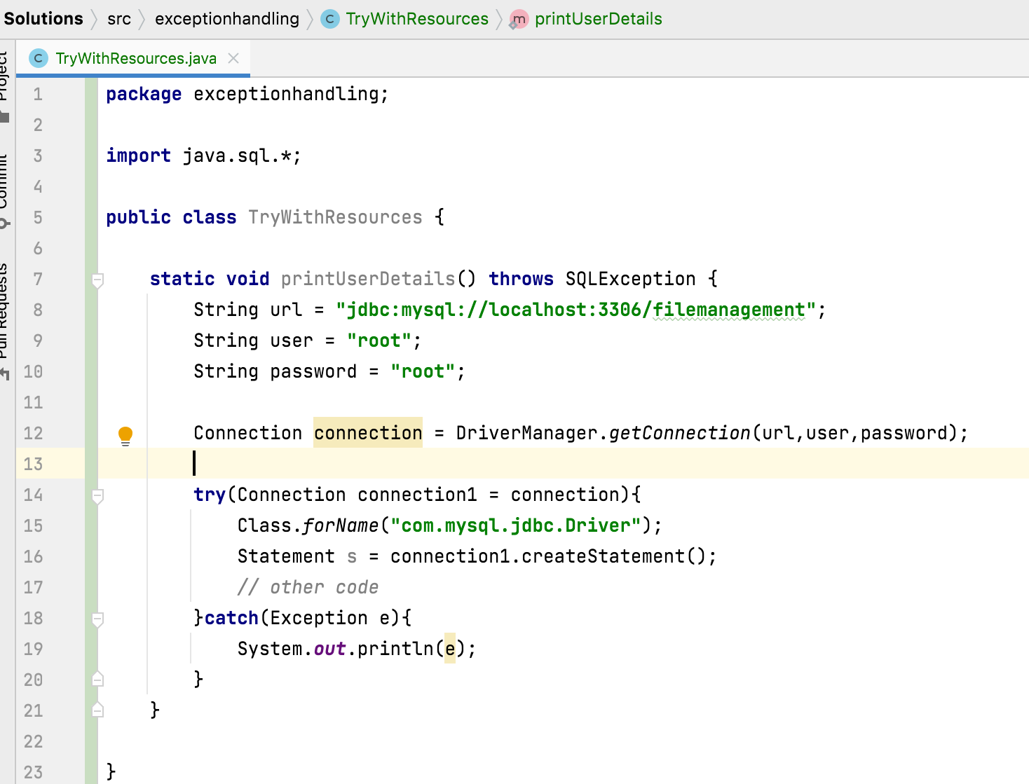
JDK7

Slide 7
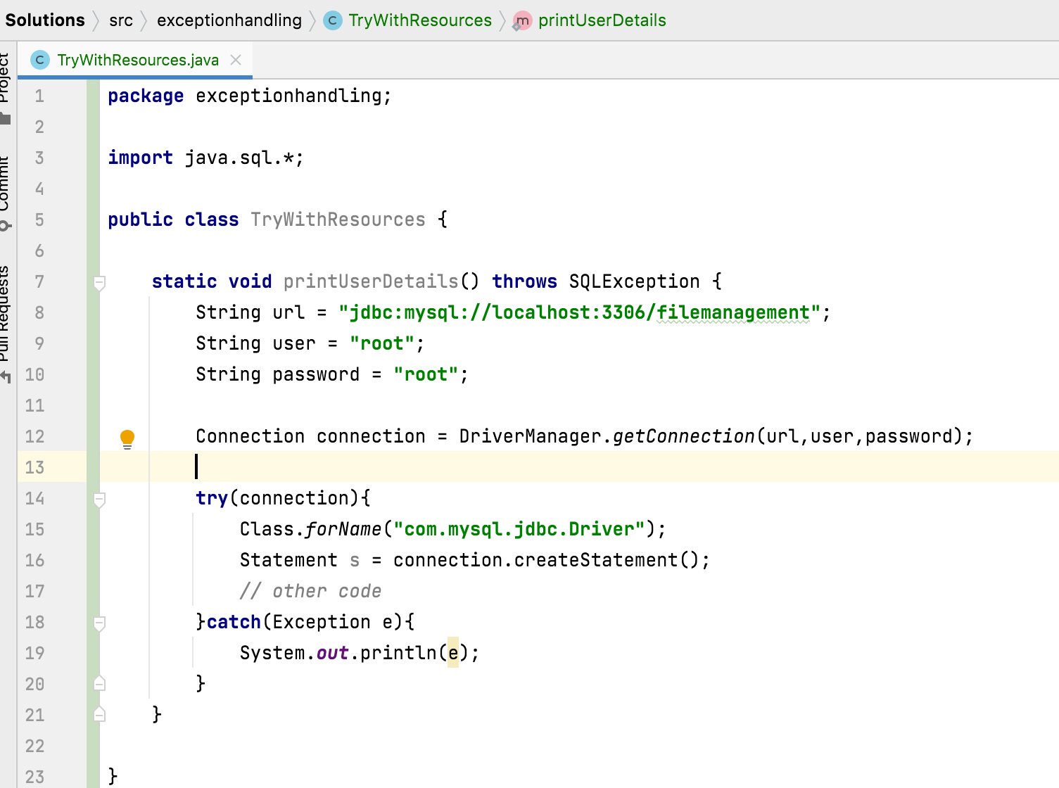
JDK9
Resource reference are supporting in try

Slide 8
How the resources closed automatically?
Resources are closed automatically by implementing java.lang.AutoCloseable interface.

Slide 9
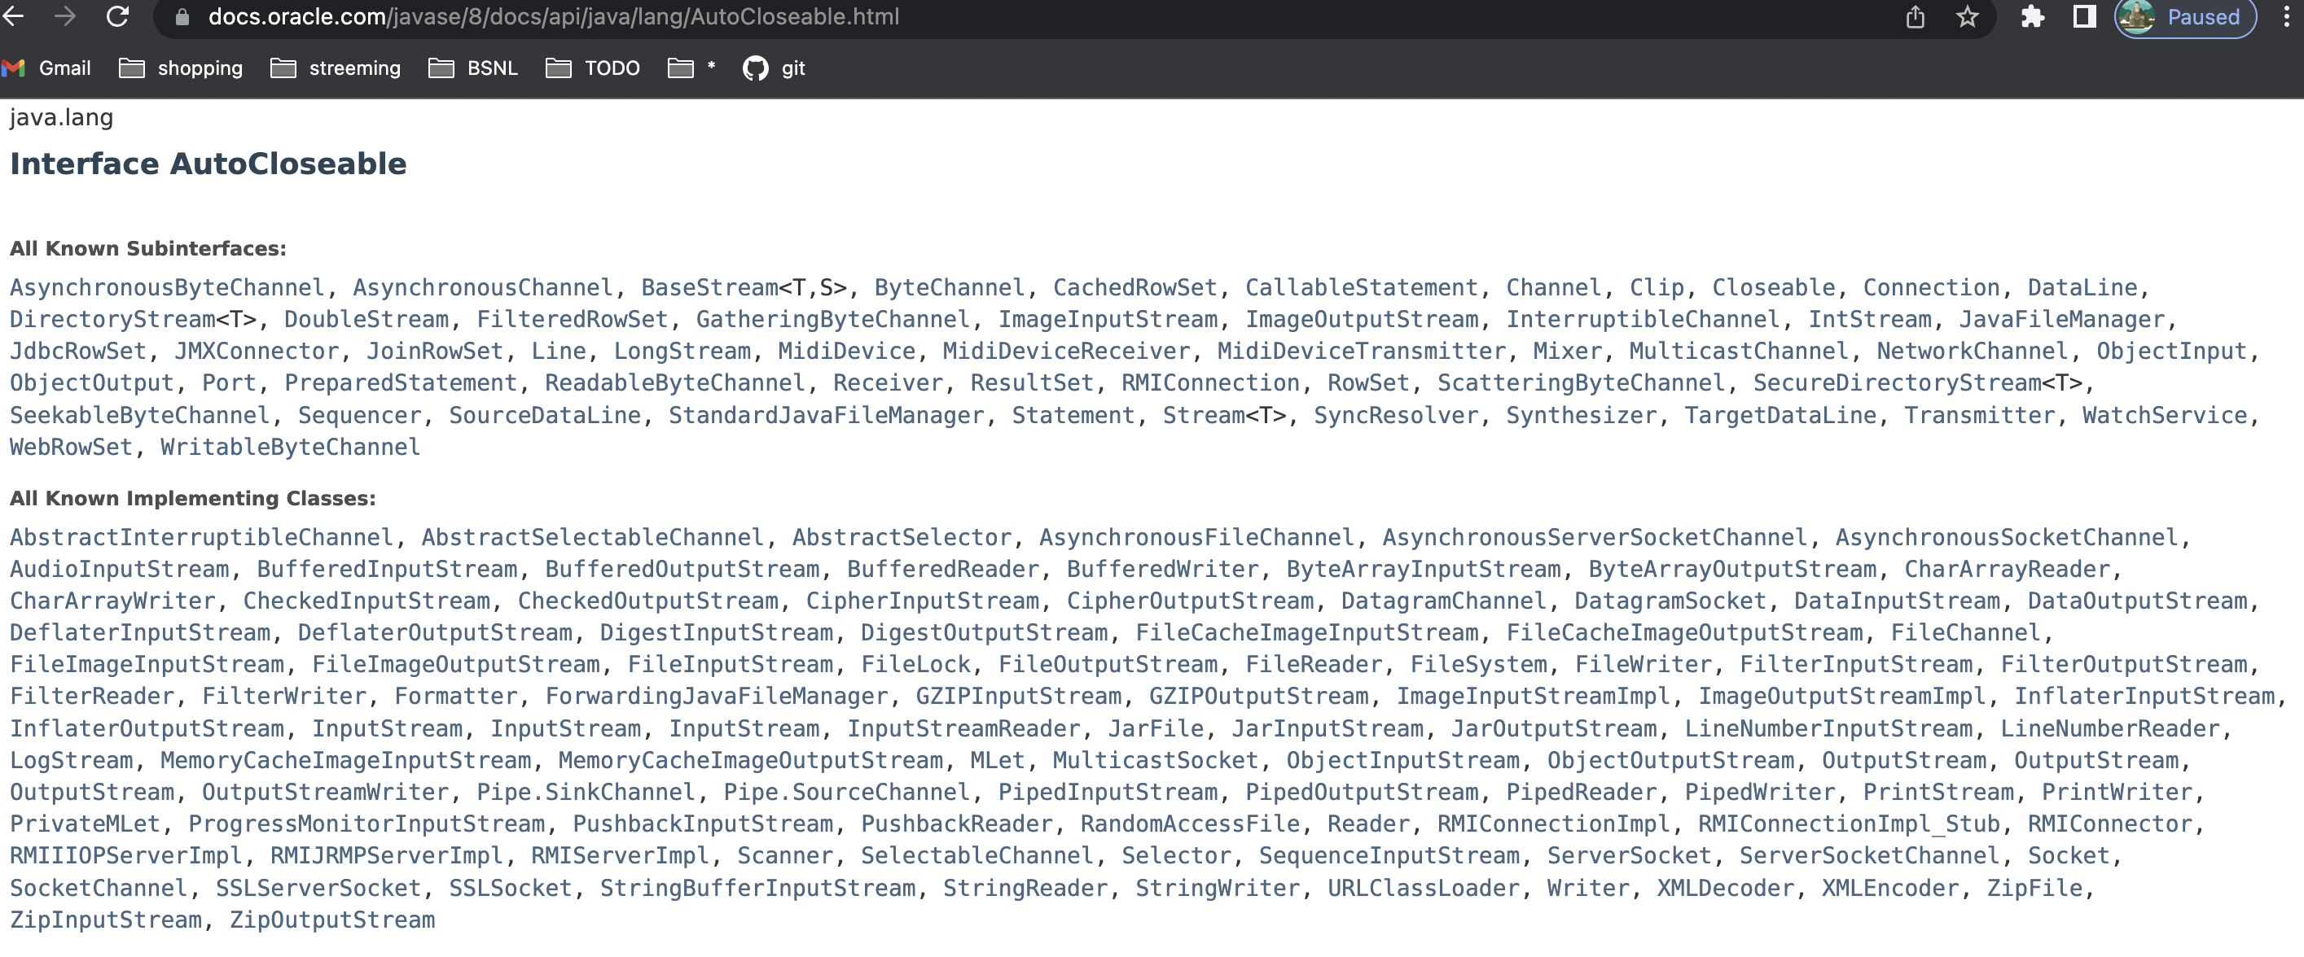


Slide 10
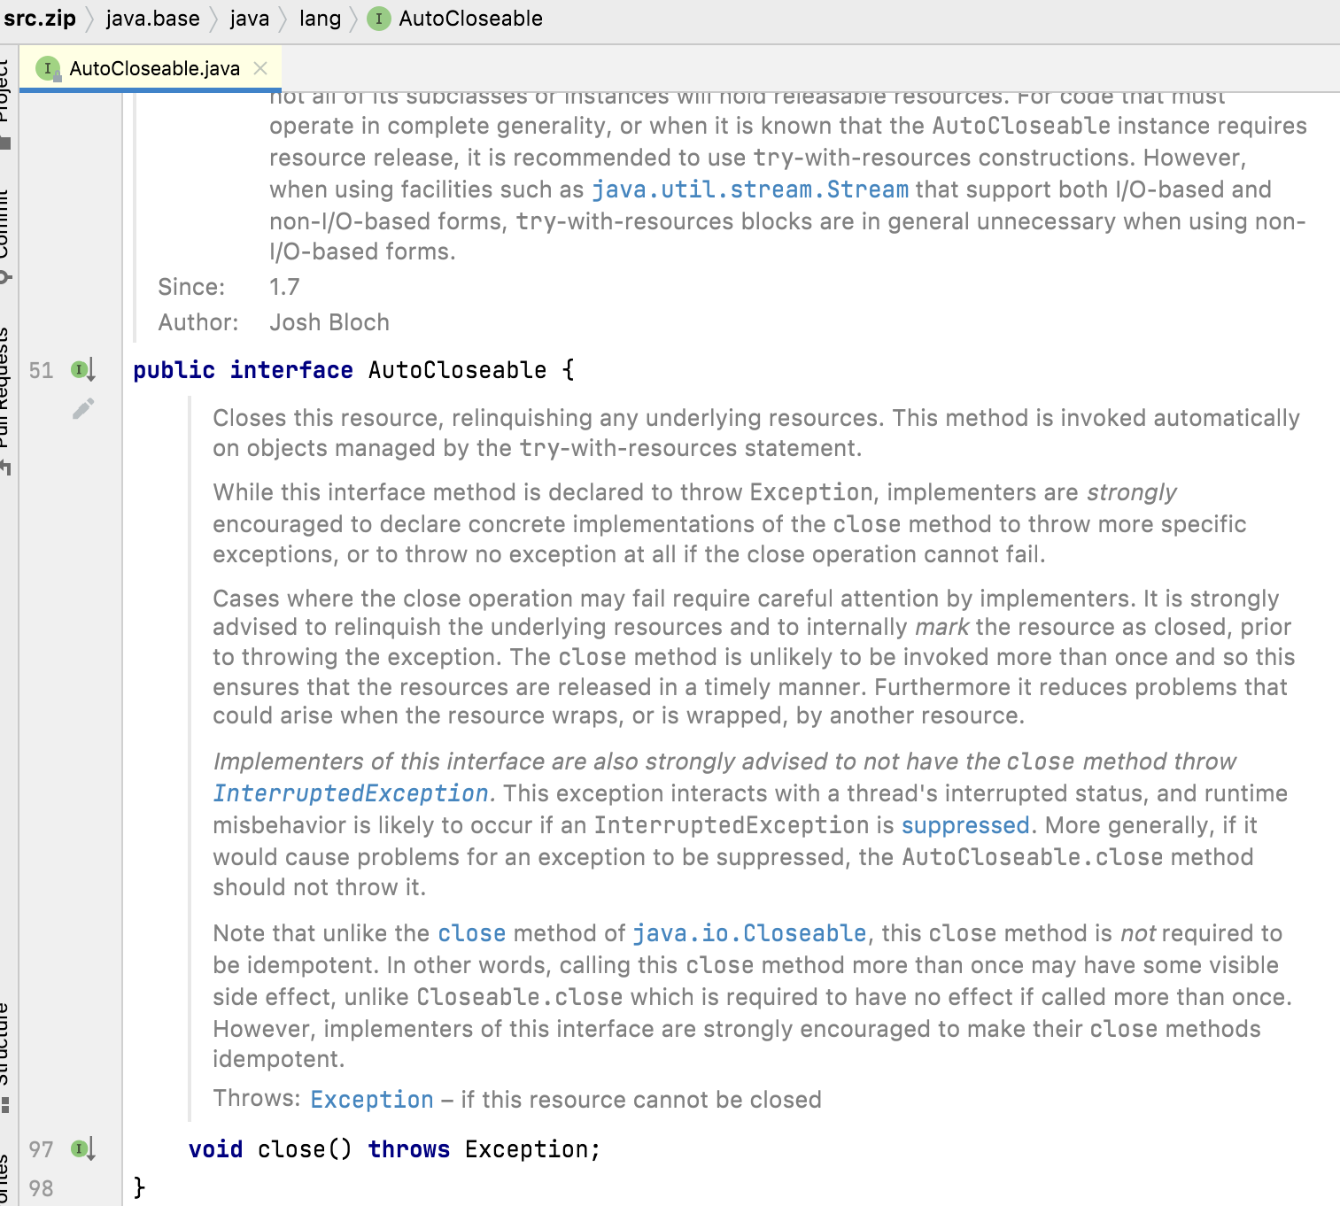

Slide 11
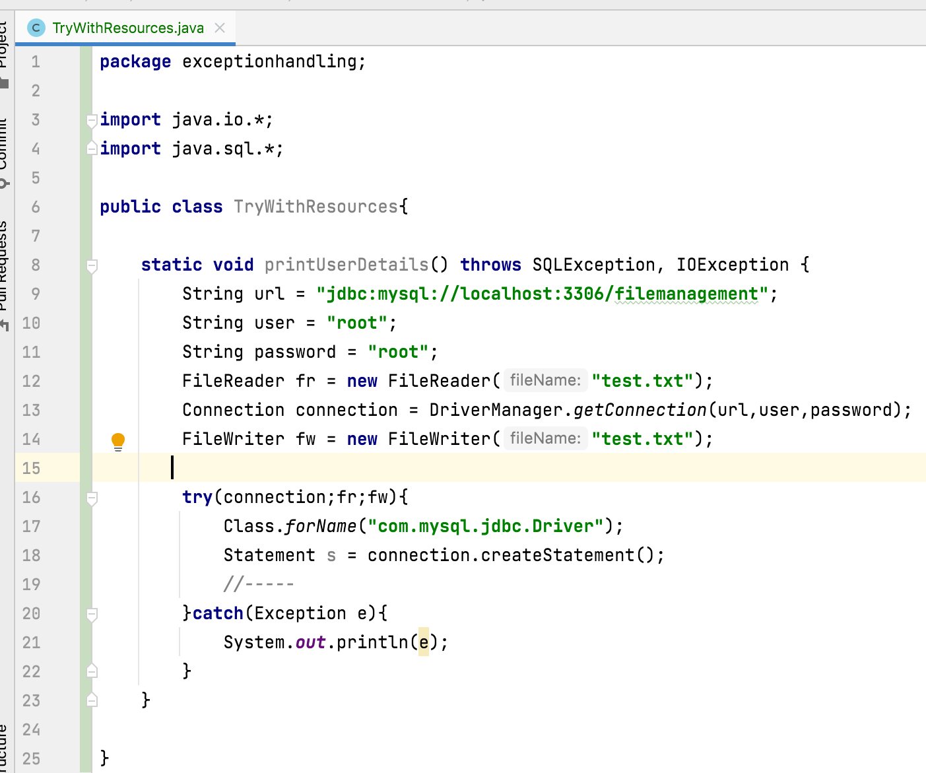
2. If we have more than one Resource how we will use ?
multiple resources can be used by separating with semicolon (;)

Slide 12
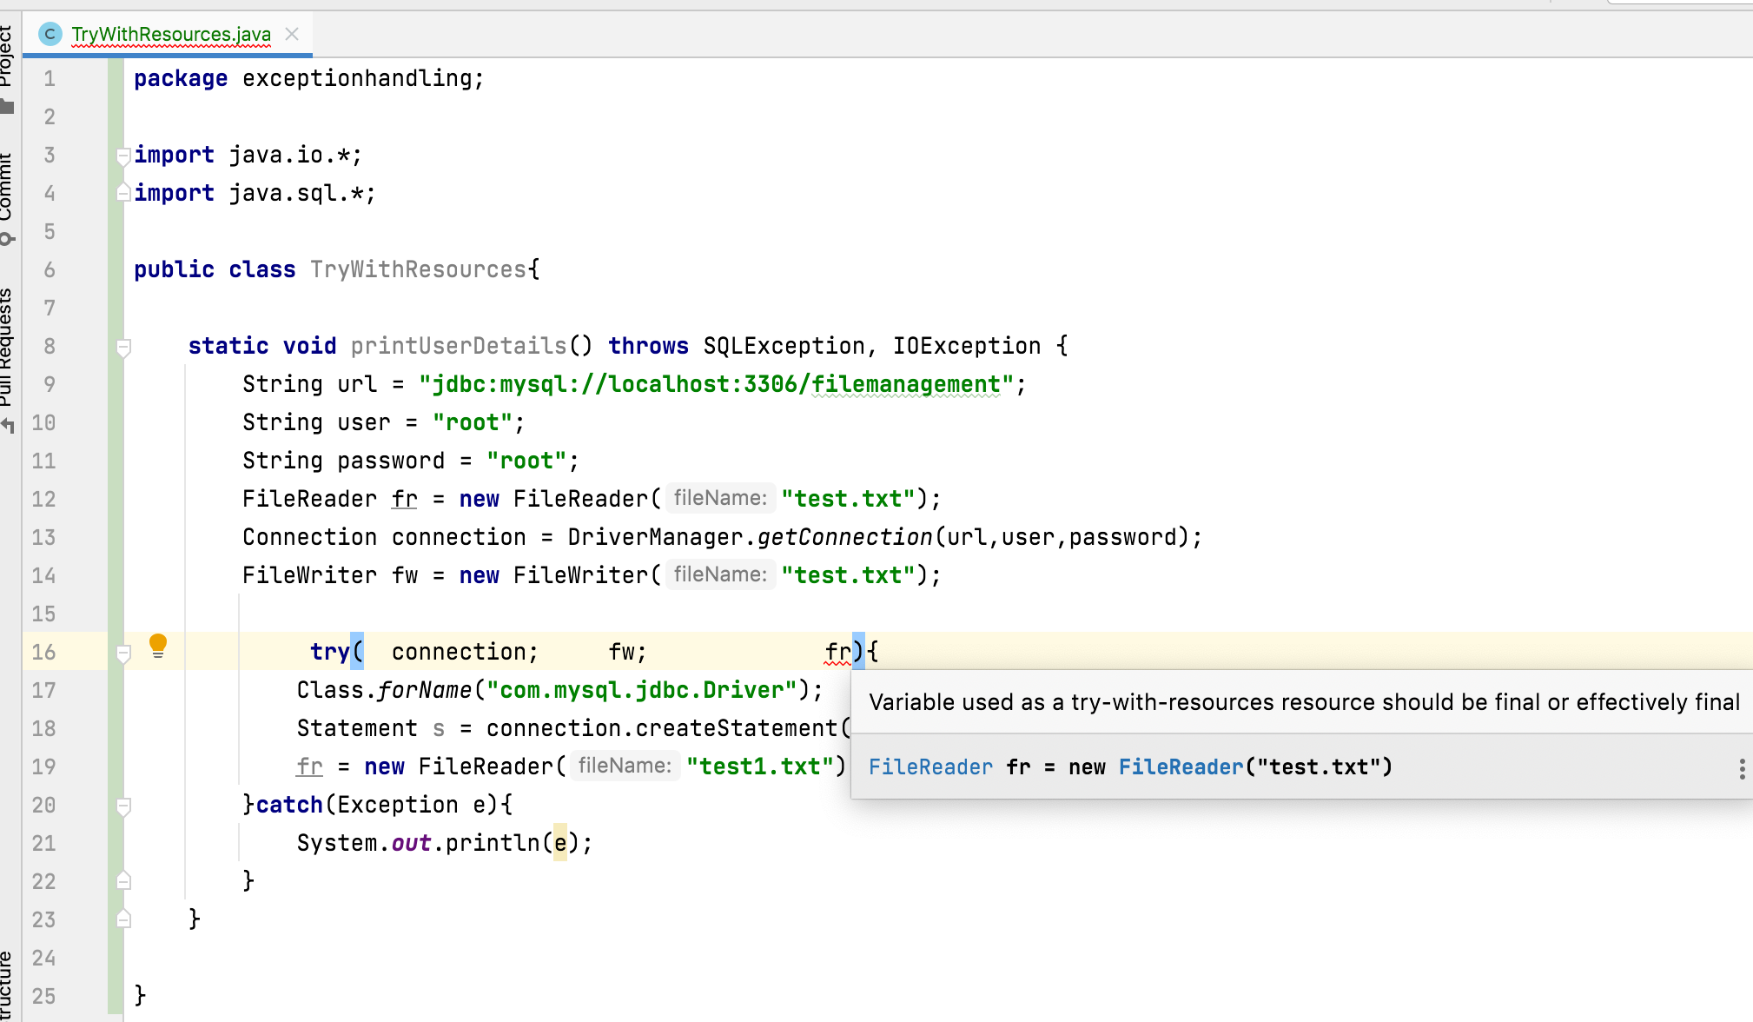
3.

Slide 13
Conclusion:
we are not required to close the resources explicitly ;
resources will be closed automatically.

Slide 14
Thank You !
momedaram

